Slide 1
ASP.NET Web API
420-C50 S21

Slide 2
ASP.NET Web API
HTTP – not just for web pages
Uses HTTP to build APIs that expose services and data
Implementation approach
MVC meets ReST
(you saw this in the ReST lecture/exercise)

Slide 3
ASP.NET Web API – view from the client side
<script>
var uri = 'api/products';
$(document).ready(function () {
// Send an AJAX request
$.getJSON(uri)
.done(function (data) {
// On success, 'data' contains a list of products.
$.each(data, function (key, item) {
// Add a list item for the product.
$('<li>', { text: formatItem(item) }).appendTo($('#products'));
});
});
});
function formatItem(item) {
return item.Name + ': $' + item.Price;
}
function find() {
var id = $('#prodId').val();
$.getJSON(uri + '/' + id)
.done(function (data) {
$('#product').text(formatItem(data));
})
.fail(function (jqXHR, textStatus, err) {
$('#product').text('Error: ' + err);
});
}
</script>
It’s ReST
Plain ole’ AJAX from javascript or jQuery

Slide 4
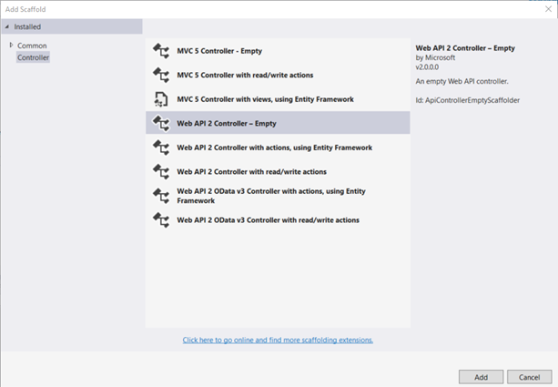
ASP.NET Web API –view from the server side
MVC “style”
Model
stays the same as MVC
CRUD or services semantics
Controller – swapped out for controller with API semantics
Accessors, mutators, services
View – don’t need no views

Slide 5
Controllers map to ReST URI
Controller Method | URI
GetAllProducts | /api/products
GetProduct | /api/products/id
using ProductsApp.Models;
using System;
using System.Collections.Generic;
using System.Linq;
using System.Net;
using System.Web.Http;
namespace ProductsApp.Controllers
{
public class ProductsController : ApiController
{
Product[] products = new Product[]
{
new Product { Id = 1, Name = "Tomato Soup", Category = "Groceries", Price = 1 },
new Product { Id = 2, Name = "Yo-yo", Category = "Toys", Price = 3.75M },
new Product { Id = 3, Name = "Hammer", Category = "Hardware", Price = 16.99M }
};
public IEnumerable<Product> GetAllProducts()
{
return products;
}
public IHttpActionResult GetProduct(int id)
{
var product = products.FirstOrDefault((p) => p.Id == id);
if (product == null)
{
return NotFound();
}
return Ok(product);
}
}
}
Notes:
Things to note:
Public methods on the API controller automatically map to ReST URI
“api” in route/path
Controller is “products”
Can return XML, JSON, Client can specify which format it wants by setting the Accept header in the HTTP request message

Slide 6
Exercise
Create new Project – WebApiSample
Template – Web API
Add Model
public class Product
{
public int Id { get; set; }
public string Name { get; set; }
public string Category { get; set; }
public decimal Price { get; set; }
}

Slide 7
Exercise
public class ProductsController : ApiController
{
Product[] products = new Product[]
{ // any bogus dummy data (normally this would be deep inside the model
new Product { Id = 1, Name = "Tomato Soup", Category = "Groceries", Price = 1 },
new Product { Id = 2, Name = "Yo-yo", Category = "Toys", Price = 3.75M },
new Product { Id = 3, Name = "Hammer", Category = "Hardware", Price = 16.99M }
};
public IEnumerable<Product> GetAllProducts()
{
return products;
}
public IHttpActionResult GetProduct(int id)
{
var product = products.FirstOrDefault((p) => p.Id == id);
if (product == null)
{
return NotFound();
}
return Ok(product);
}
}
Create new Project – WebApiSample
Template – Web API
Add Model
Add Controller (Web API 2)
Notes:
Note:
Added to Controller folder

Slide 8
Exercise
<!DOCTYPE html>
<html xmlns="http://www.w3.org/1999/xhtml">
<head>
<title>Product App</title>
</head>
<body>
<div>
<h2>All Products</h2>
<ul id="products" />
</div>
<div>
<h2>Search by ID</h2>
<input type="text" id="prodId" size="5" />
<input type="button" value="Search" onclick="find();" />
<p id="product" />
</div>
<script src="http://ajax.aspnetcdn.com/ajax/jQuery/jquery-2.0.3.min.js"></script>
<script>
var uri = 'api/products';
$(document).ready(function () {
// Send an AJAX request
$.getJSON(uri)
.done(function (data) {
// On success, 'data' contains a list of products.
$.each(data, function (key, item) {
// Add a list item for the product.
$('<li>', { text: formatItem(item) }).appendTo($('#products'));
});
});
});
function formatItem(item) {
return item.Name + ': $' + item.Price;
}
function find() {
var id = $('#prodId').val();
$.getJSON(uri + '/' + id)
.done(function (data) {
$('#product').text(formatItem(data));
})
.fail(function (jqXHR, textStatus, err) {
$('#product').text('Error: ' + err);
});
}
</script>
</body>
</html>
Create new Project – WebApiSample
Template – Web API
Add Model
Add Controller
Add Client Page to test (add new item -> html page)

Slide 9
Exercise
Create new Project – WebApiSample
Template – Web API
Add Model
Add Controller
Add Client Page to test
Let’s run it
Pull up the HTML page you created
Examine the network console to view the AJAX request and response
Notes:
Examine network console for the sample page, note the XHR (AJAX) requests
URI, ACCEPT
Also note response
Cool how controller automatically serialize to appropriate format

Slide 10
API Controller Return Types
void
public class ValuesController : ApiController
{
public void Post()
{
}
}
HTTP Response
HTTP/1.1 204 No Content
Server: Microsoft-IIS/8.0
Date: Mon, 27 Jan 2014 02:13:26 GMT
Notes:
Returns and empty HTTP Response with status code 204 (No Content)

Slide 11
API Controller Return Types
HttpResponseMessage
public class ValuesController : ApiController
{
public HttpResponseMessage Get()
{
HttpResponseMessage response = Request.CreateResponse(HttpStatusCode.OK, "value");
response.Content = new StringContent("hello", Encoding.Unicode);
response.Headers.CacheControl = new CacheControlHeaderValue()
{
MaxAge = TimeSpan.FromMinutes(20)
};
return response;
}
}
HTTP Response
HTTP/1.1 200 OK
Cache-Control: max-age=1200
Content-Length: 10
Content-Type: text/plain; charset=utf-16
Server: Microsoft-IIS/8.0
Date: Mon, 27 Jan 2014 08:53:35 GMT
hello
Notes:
More fine grained control of the response message based on properties of the HTTPResponseMessage object

Slide 12
API Controller Return Types
IHttpActionResult
Method
Ok() | Creates an OkResult (200 OK)
NotFound | Creates a NotFoundResult
Json<T>(T) | Creates a JsonResult<T>(200 OK) with the specified value
Notes:
More fine grained control of the response message based on properties of the HTTPResponseMessage object

Slide 13
Closing comments
Web API
ReST repackaged by Microsoft with lessons learnt from MVC
Some nice abstractions on mapping methods to URIs and serializing/deserializing

Slide 14
References
MSDN REST Guide
Getting Started with Web API 2 (C#)

